Slide 1

Kira municipal council
Presentation on development trends, achievements for the last 3 years and way forward
to
Kira municipality key stakeholders
5th December 2019

Slide 2
Outline
Background of Kira MC
Kira Municipality Development Trends
Key achievements over the last 3 years
Key development challenges
Planned interventions and budget available
Concluding remarks and way forward

Slide 3
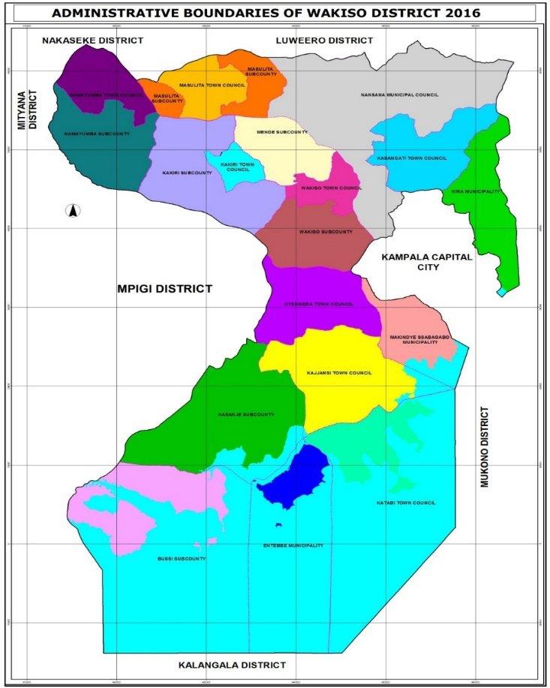
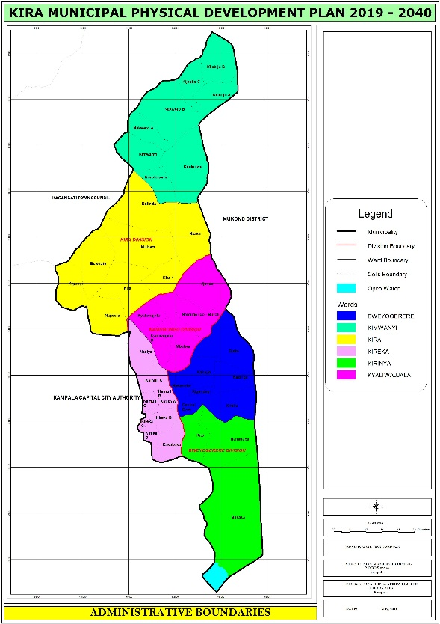
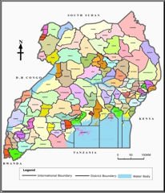

BACKGROUND
BUSIRO
Kira Municipality is located in the Wakiso District in the Central Region of Uganda
Lies approximately 5.3 kilometres by road, East of Kampala, the capital city of Uganda.
Kira Municipality is the country's second-largest town by population in the country
Total land area of 98.83 km²

Slide 4
Background-cont’d
Kira started as a Town Council in July 2003
It was elevated to a Municipality status in September 2015; operationalized July 2016
Bordered by Mukono MC, Kasangati TC and Kampala City
Made up of three (3) Divisions, six (6) Wards and fifty four (54) Cells
Population: 434,200 (UBOS,2019)
Population growth rate 10.44%(national average is 3.26% per annum)
Population density 3,324 persons per km²
(NATIONAL AVERAGE IS 183.27 PERSONS PER KM²)

Slide 5
Kira municipality development trends

Slide 6
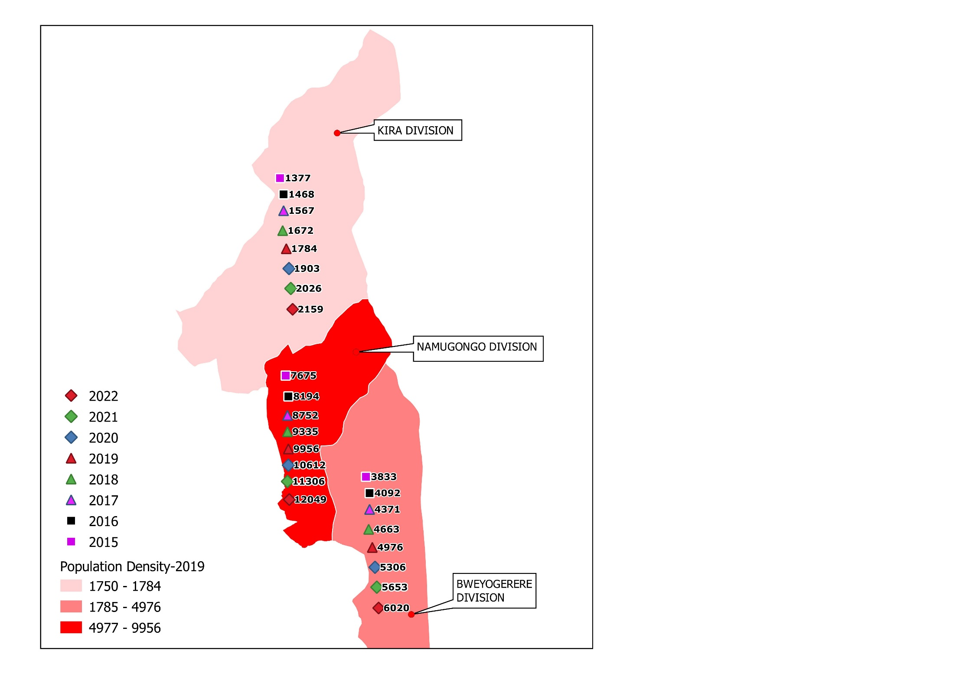
Population density
Increasing population density which has strained the existing infrastructure and sometimes leading to informalities

Slide 7


Slide 8
HOUSING CONDITIONS

Slide 9
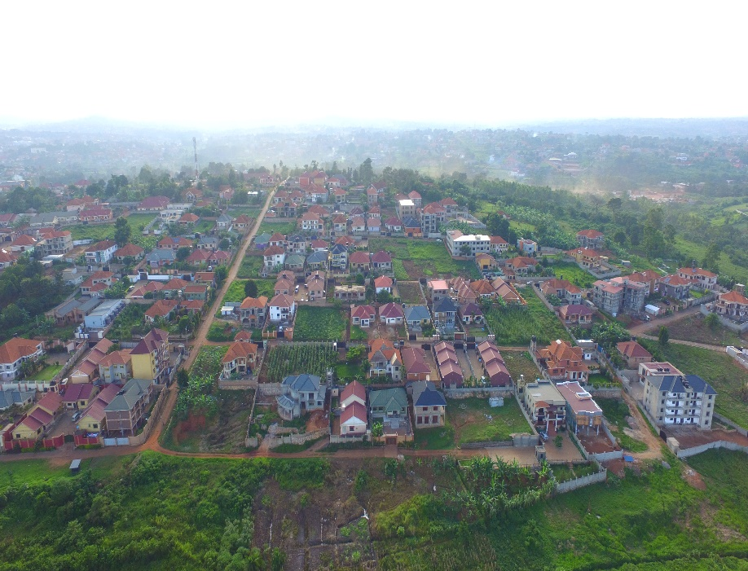
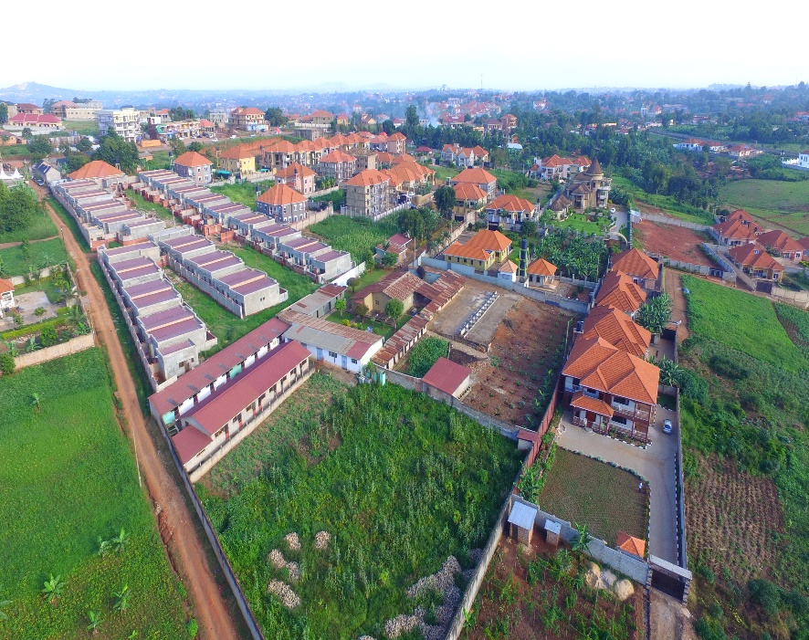
HOUSING ESTATES
Naalya Housing Estate
National Housing Naalya
Parliamentary Housing
Estate-Kitukutwe
Jomayi Kiti Kifumba
Jomayi Mulawa
Akright Nsasa
Akright Nakwero
Canaan Estates Nakwero
Jomayi Bukasa

Slide 10
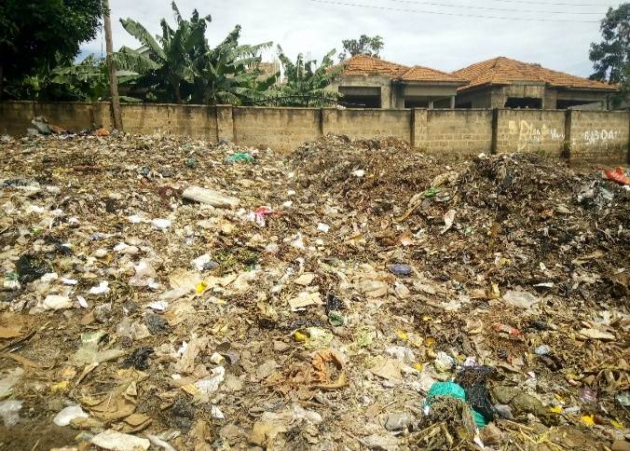
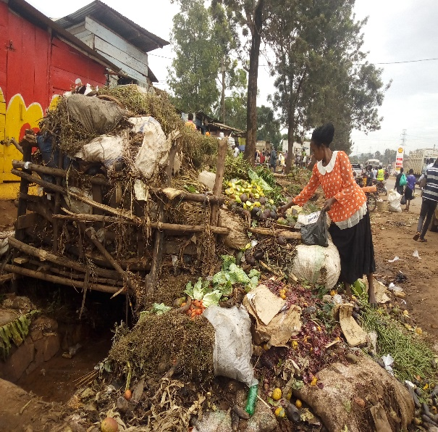
Solid waste in Kira
Local Authority | Current Population | Solid Waste Generated kg/capita/day | Solid Waste Generated kg/day | Solid Waste Generated tons/month
 | 2019
Bweyogerere | 146,300 | 0.579 | 92,029 | 2,761
Kira | 82,800 | 0.579 | 52,111 | 1,563
Namugongo | 205,100 | 0.579 | 129,045 | 3,871
Total | 434,200 |  | 273,186 | 8,195
Average generation rate is 0.579 kg/ capital/day
Production 273 tons/day or 8195 tons/months of solid waste.
It costs UGX 20,000/= to collect one ton at household level (OAG, 2010). The cost is based on the assumption that there is a specified truck and a functional disposal site
A capital outlay of UGX 163.6 Million/month or 1.963 billion/year.(provide current operational expenditure on garbage-Flora)

Slide 11
Roads
1. Network
Category | Length (Km)
Tarmac | 50
Earth | 242
Total | 292
2. Condition for the last 2 FYs
Description | Good |  | Fair |  | Poor |  | Total
FY | 17/18 | 18/19 | 17/18 | 18/19 | 17/18 | 18/19
Length | 58.3 | 81.8 | 85 | 105.1 | 148.7 | 99.1 | 292
Percentages | 20% | 28% | 29.1% | 36% | 50.9% | 34% | 100%

Slide 12
Government Health Facilities
Health Facility | Threshold Population per facility | Current Situation | Demand | Remarks
Health Centre IV | 100,000 | 0 | 4 | Deficit of four Health Centre IVs
Health Centre III | 20,000 | 9 | 22 | Deficit of 13
Fire Station | 1:100,000 | 0 | 4 | Current requirement for 4 fire stations since this service is totally lacking in the municipality

Slide 13
Education Services
Projected Population |  |  | 2018 | 2028 | 2038 | 2040
 |  |  | 433,088 | 943,699 | 2,056,317 | 2,402,932
Service | Service Standards | Existing Numbers | Demand | Requirement
Secondary Schools | 10,000 people | 46 | 43 | 94 | 206 | 240
Primary Schools | 5,000 people | 354 | 87 | 189 | 411 | 481
Vocational | 50,000 people | 0 | 9 | 19 | 41 | 48

Slide 14
Total BUDGET GROWTH TRENDS(17/18-19/20)’000
Despite the growth in revenue over the three year period, the income of the municipality is still low compared to the demand of infrastructure and services.

Slide 15
BUDGET TRENDS (17/18-19/20) by source category

Slide 16
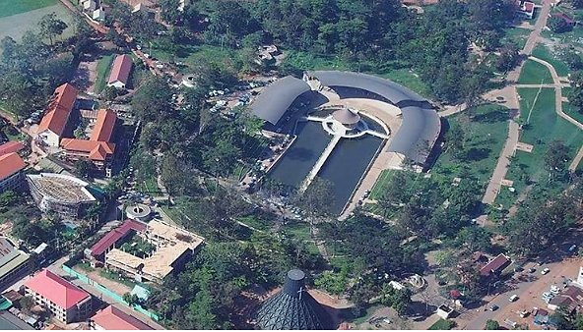
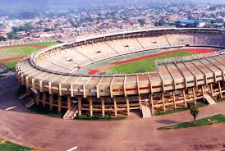
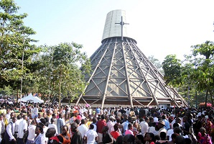
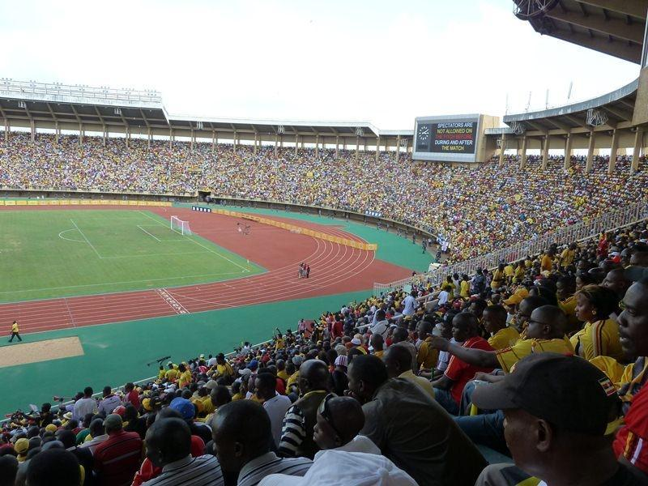
Tourism potential
Namugongo martyrs shrine
Mandela National stadium

Slide 17
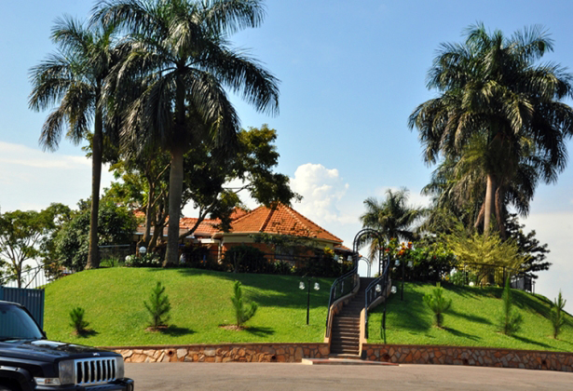
Tourism potential
KABAKA’S PALACE-KIREKA

Slide 18
Key achievements over the last 3 years

Slide 19
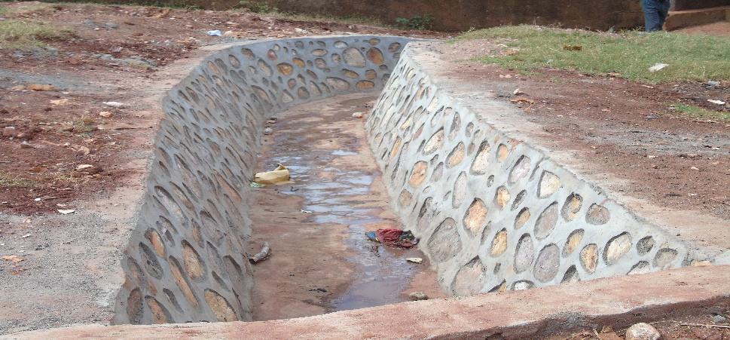
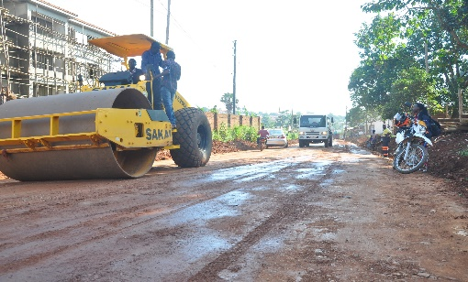
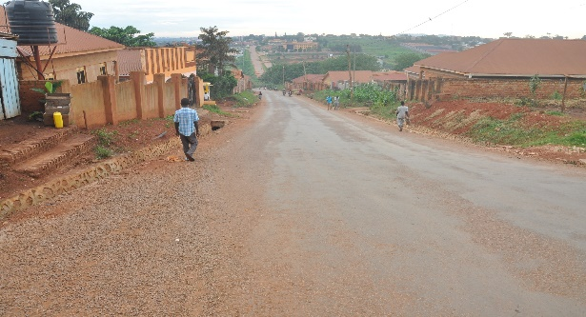
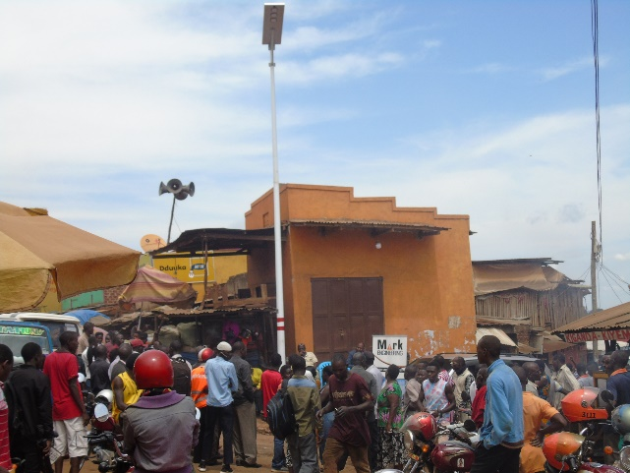
roads
Stone pitching of a number of roads(drainage construction)
Periodic maintenance by widening, gravelling and drainage works along:
  Kito Main Road
  Ndiwulira Road
Upgrade to tarmac of 50 Kms of roads(19.5kms in the last 3 years)
Security lighting along
Kabaka’s road and other trading centers
(61 smart solar street lights)

Slide 20
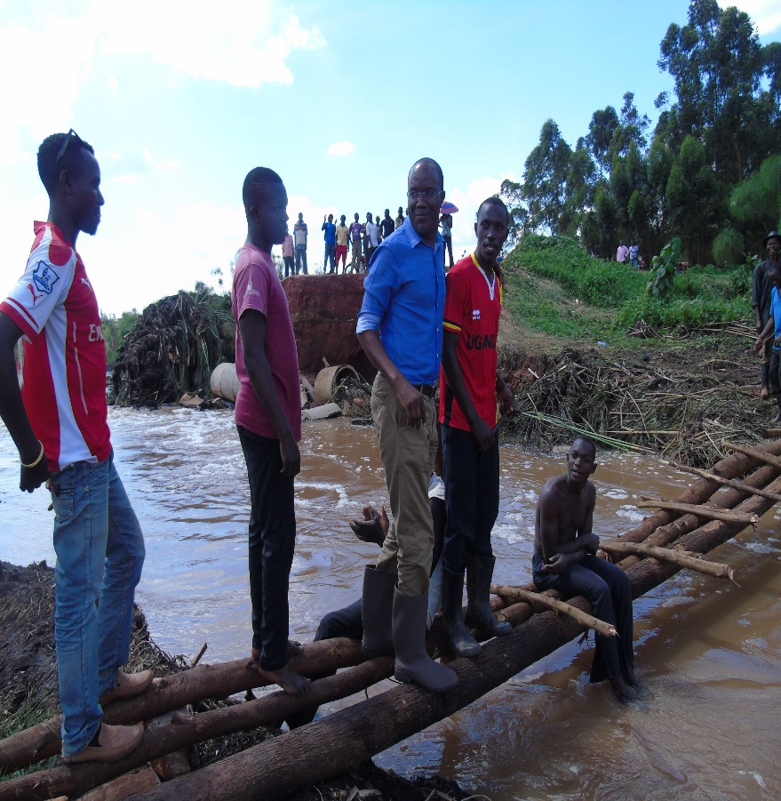
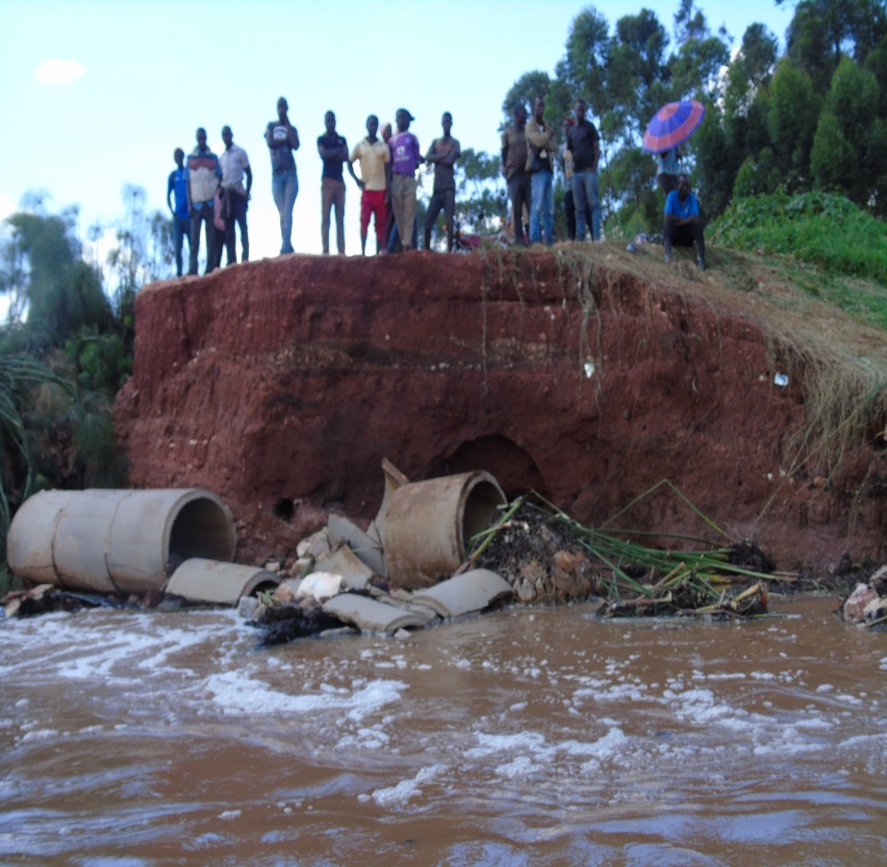
Roads-cont’d
Nakalere(road from Kiwologoma-Kimwanyi to Gayaza –Kalagi Rd –in danger

Slide 21
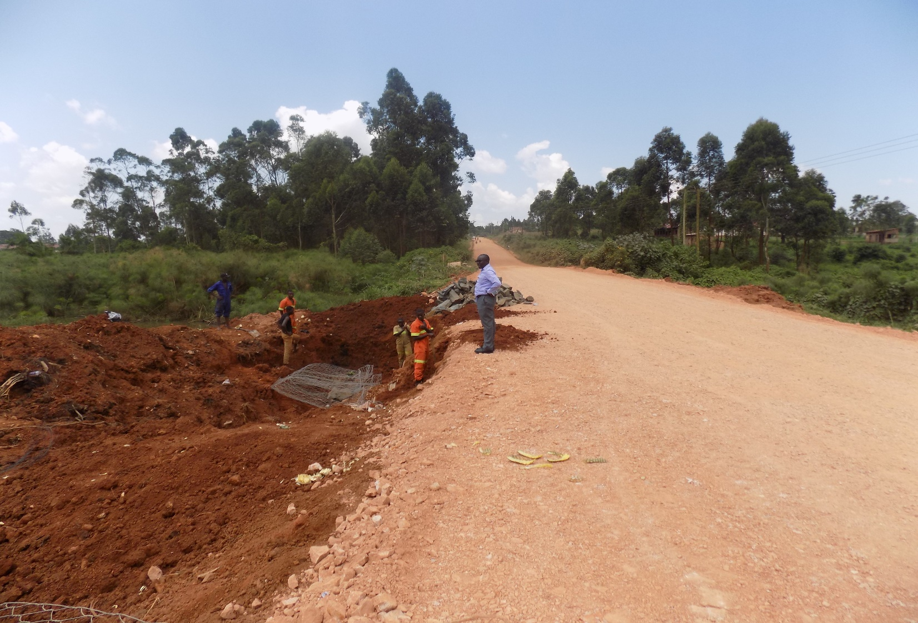
Roads-cont’d
Nakalere –during intervention

Slide 22
Roads-cont’d
Description | Financial Year | Location | Length (Km)
Up-grade to Tarmac | 16/17 | Bulindo - Kiwologoma - Nakweero | 1.45
 |  | Azam – Makanga Constance road | 0.3
 |  | Kungu Road | 0.4
 |  | Kiwologoma - Kijjabijjo | 0.1
 | 17/18 | Kiwologoma – Nakweero I | 0.7
 |  | Kungu Road | 0.3
 | 18/19 | Kiwologoma – Nakweero II | 2.9
 |  | Kito Main Road | 1.0
 |  | Mbalwa - Agenda | 0.4
 |  | Nabwojjo Road | 0.25
 |  | Ndiwulira Road | 1.5
 |  | Kireka Umea Shell SDA | 0.4
 |  | Kungu Road | 0.25
 |  | Serinya Road | 0.6
Second Seal | 16/17 | Kireka – Kamuli - Naalya | 0.6
 |  | Bethany Road | 0.4
 | 17/18 | Kira - Kiwologoma - Nakweero | 1.2
Street Lights | 16/17 | Kabaka Road | 15No
 | 18/19 | Selected Trading Centres | 46No

Slide 23
Health AND SANITATION
Provision of 10,000 liter water tanks to Kira HC III, Kimwanyi HC II and Kireka HC II
Renovation of Kimwanyi HC II
Construction of staff quarters at Kira HC III-turned into an extension of the facility
Construction of modern water borne toilets
Construction of a water placenta pit at Kireka HC II
Acquisition of an ambulance and assortment of medical equipment in conjunction with development partners
Acquisition of a modern laboratory and specialized family planning clinic
Purchased land for solid waste management in Menvu –Nansana Municipality(12 acres)

Slide 24
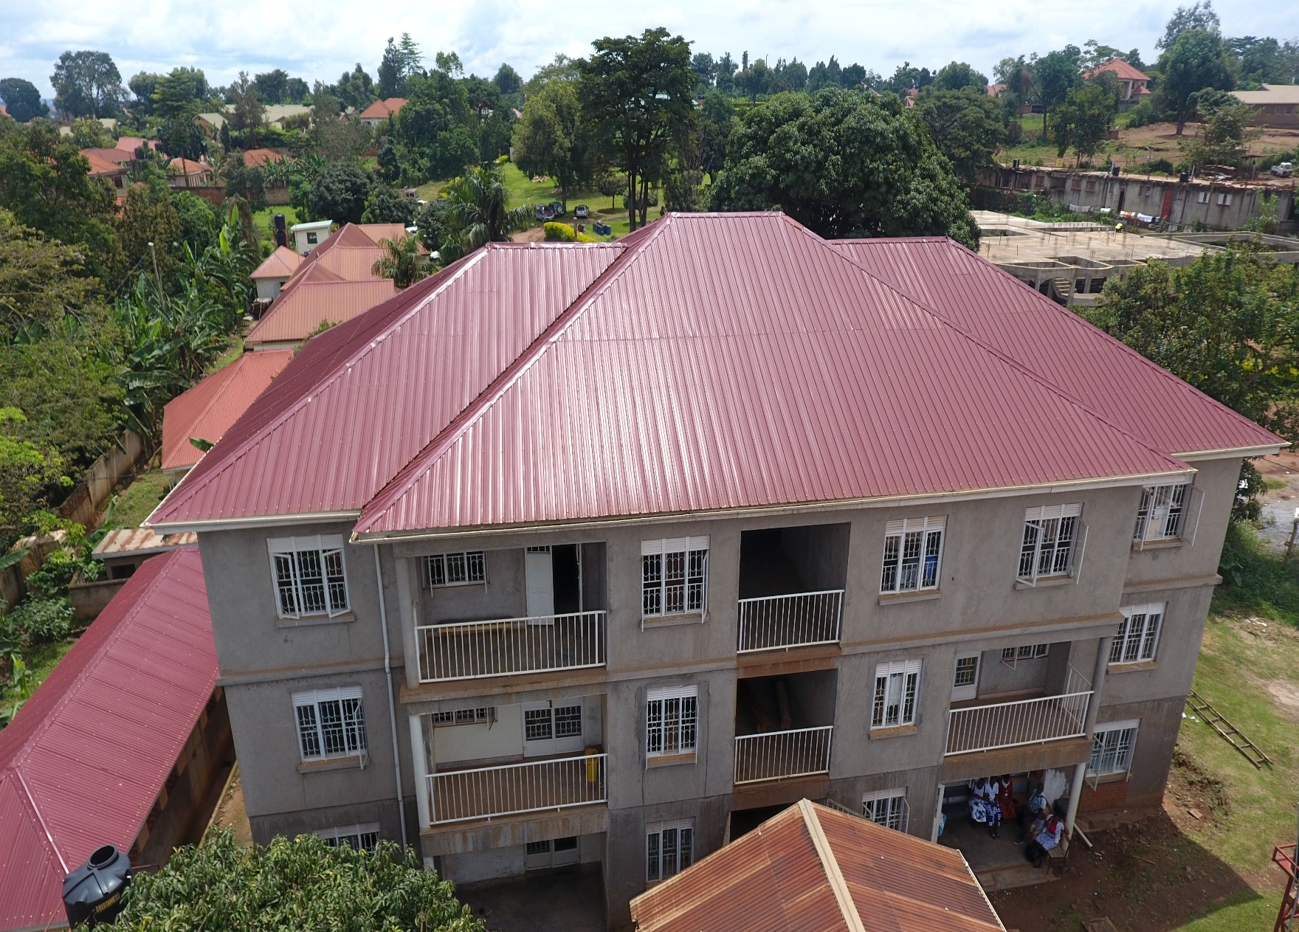
Health AND SANITATION-kira hc iii complex

Slide 25
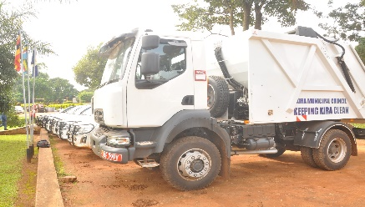
Health AND SANITATION-brand new garbage truck

Slide 26
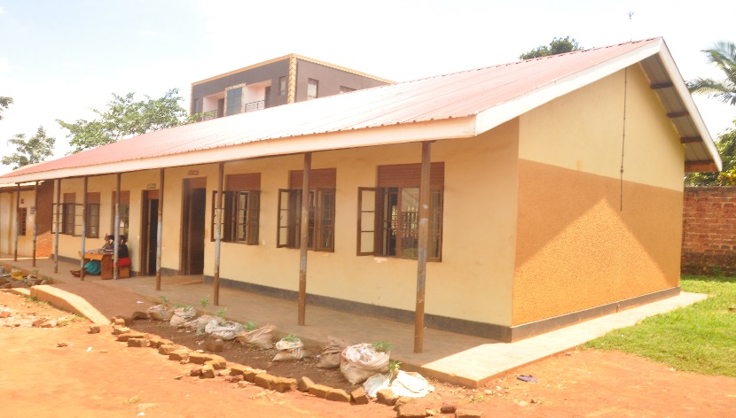
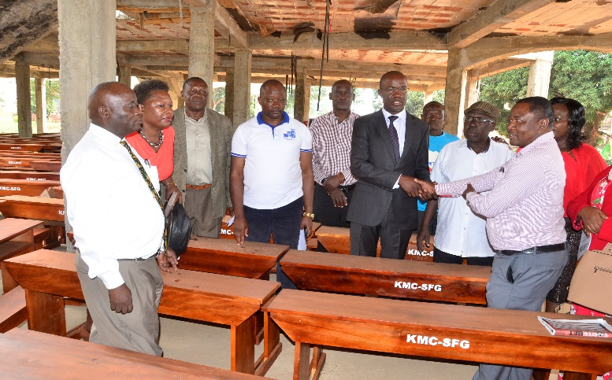
Education SERVICES
Construction of classroom blocks-Buwaate C/S, Kirinya C/S, Kirinya C/U P/S, Bweyogerere C/U P/S, Kimwanyi UMEA P/S, Nakwero COU Sec School, Bweyogerere Muslim P/S
Construction of 5 Stance Pit Latrine at Kirinya C/U P/S, Kireka UMEA P/S, Namugongo Girls Boarding P/S and Kitukutwe P/S
Renovation of classroom block at Kamuli C/U P/S and Kireka UMEA P/S,
Construction of a water borne toilet for Bweyogerere Bazadde P/S
Provision of six hudred(600) 3 seater desks to all Government aided Primary Schools
Provision of five(5) water tanks to different primary schools

Slide 27
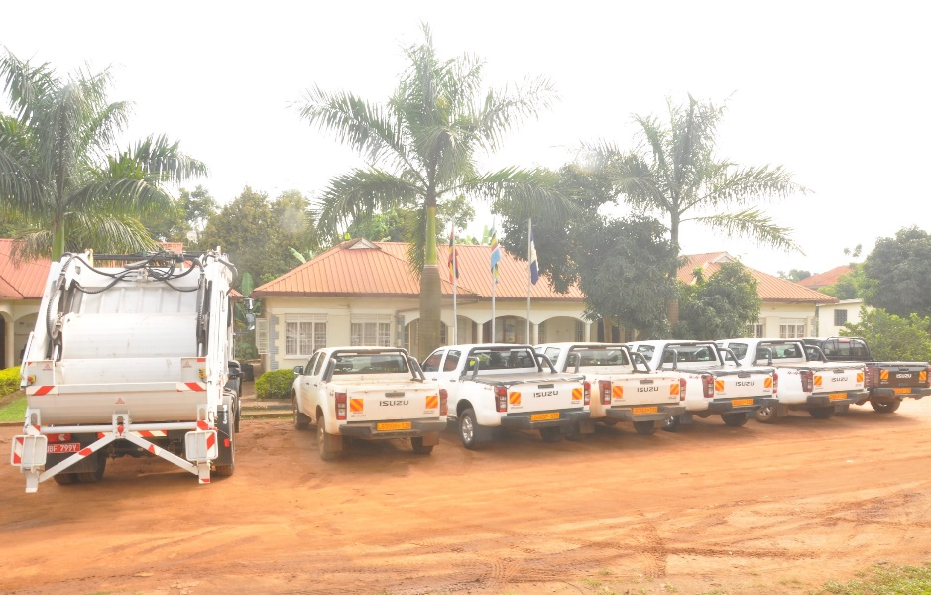
administration
Completion of Municipality Development Plan 2015/2016 – 2019/2020
Development of the Physical Development Plan 2019-2040
Purchase and installation of computer software for management of property rates
Construction of Administration block and Bweyogerere division offices
Opening up of Kira Municipality boundaries
Acquisition of 6
departmental vehicles

Slide 28
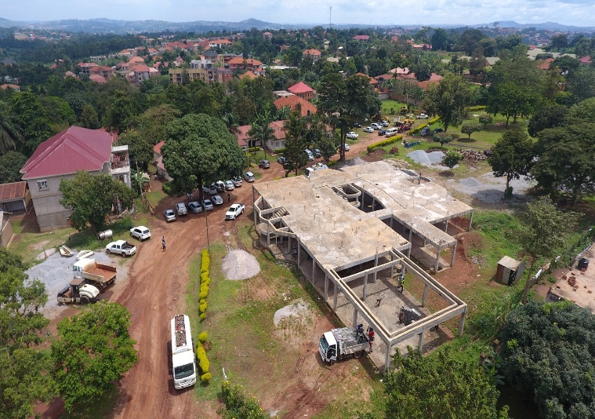
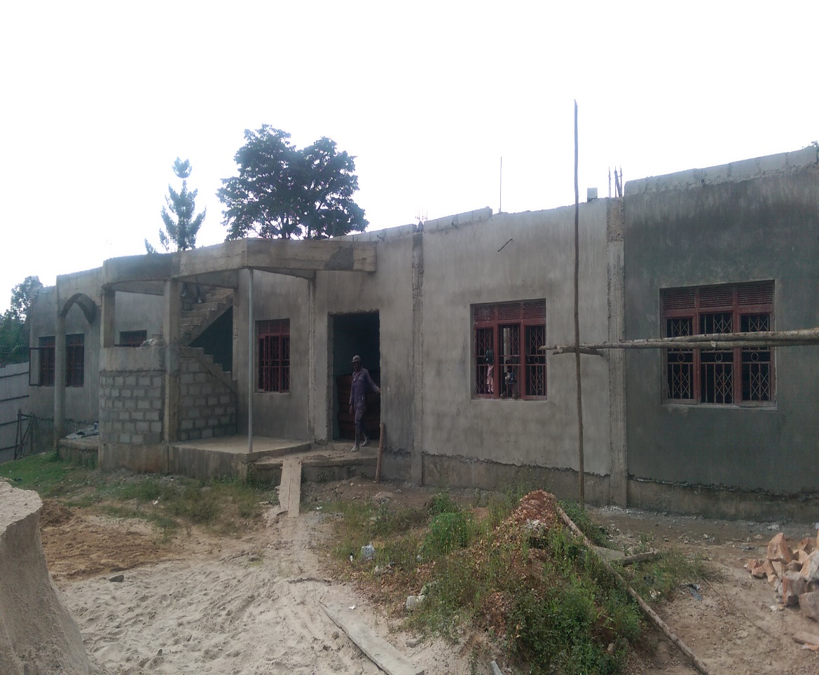
Administration-cont’d
Administration Block under construction
Aerial View
Side View

Slide 29
Key Development challenges

Slide 30
Development challenges
Inadequate revenue to finance physical and social services.
Inadequate manpower due to limited wage bill(at 57%) –this affects physical planning control
Perceived double taxation from property rates by the Municipal Council vs rental tax by URA
Pressure on existing road infrastructure from settlements and industrial development
Informal settlement with both high & low quality housing.
No public vocational and tertiary institutions
Illegal encroachment of public land (Kasokoso, Kitto, Namataba, Bukasa etc).
Land values are on an irreversible increasing trend. This situation will have costly implications to future infrastructure development(i.e compensation values for resettlement).
Inadequate health centers and essential medicines

Slide 31
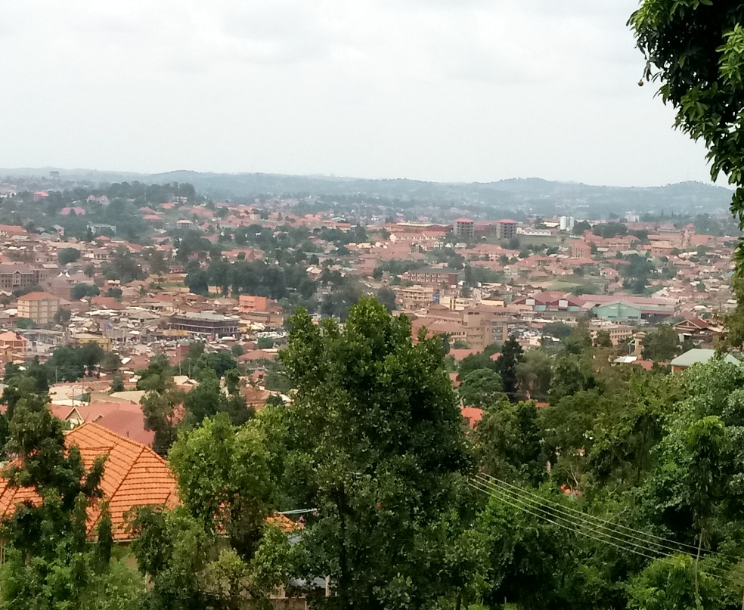
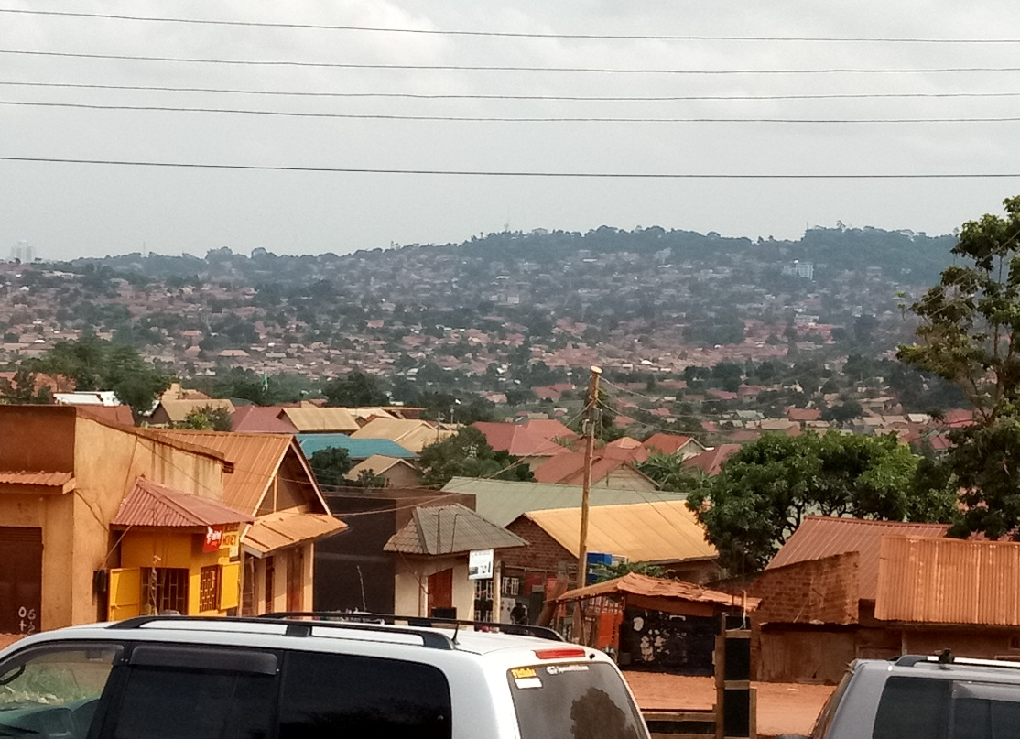
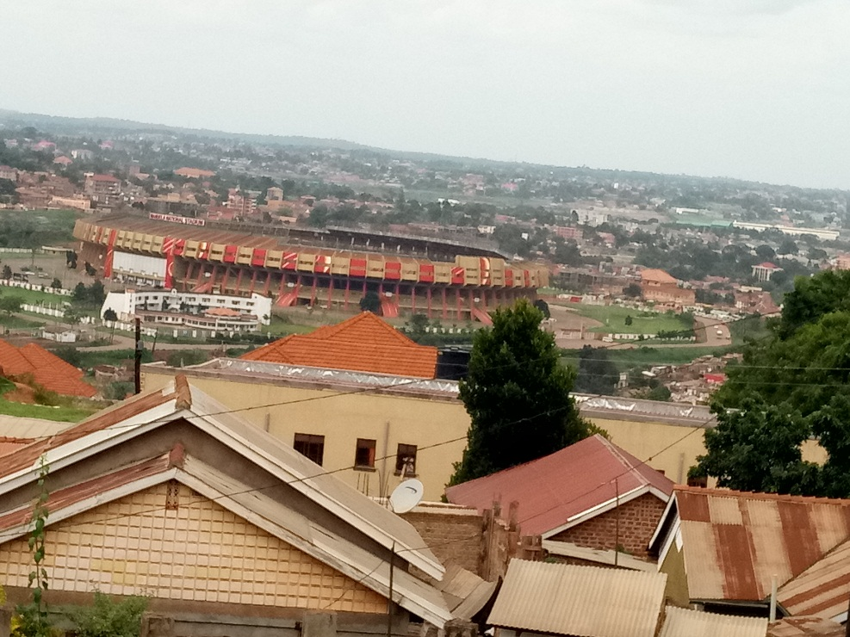
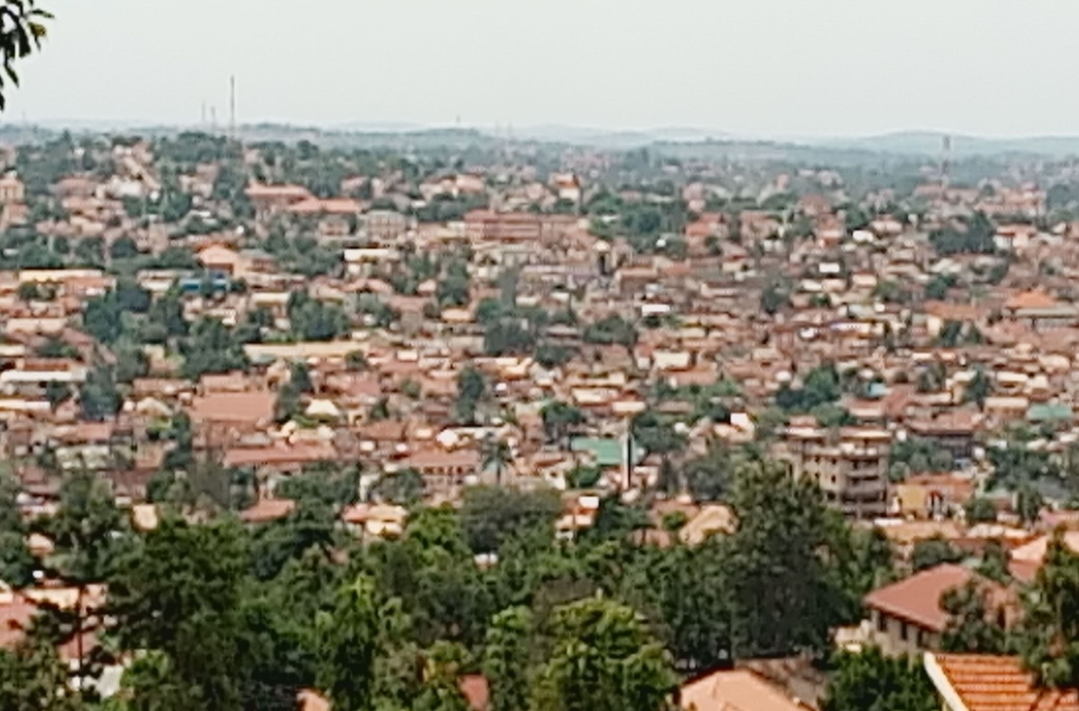
Disjointed incrementalism

Slide 32
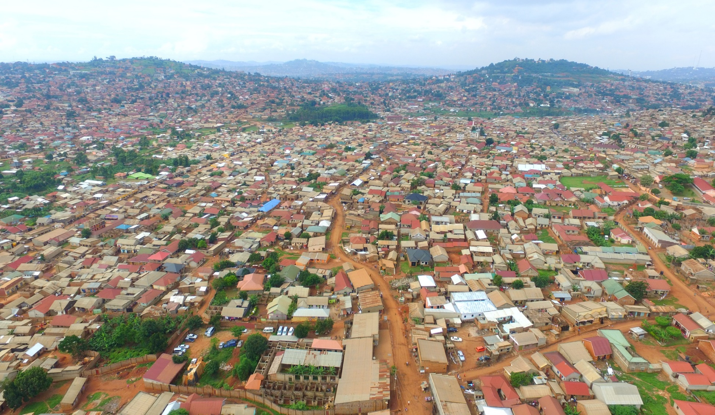
Kireka B, C, D and Kasokoso residential areas;
▪ Organic growth on very prime and central location within proximity of KCCA
▪ Inadequate infrastructural development and services(sanitation, solid waste, connectivity, security, informalities, etc)

Slide 33
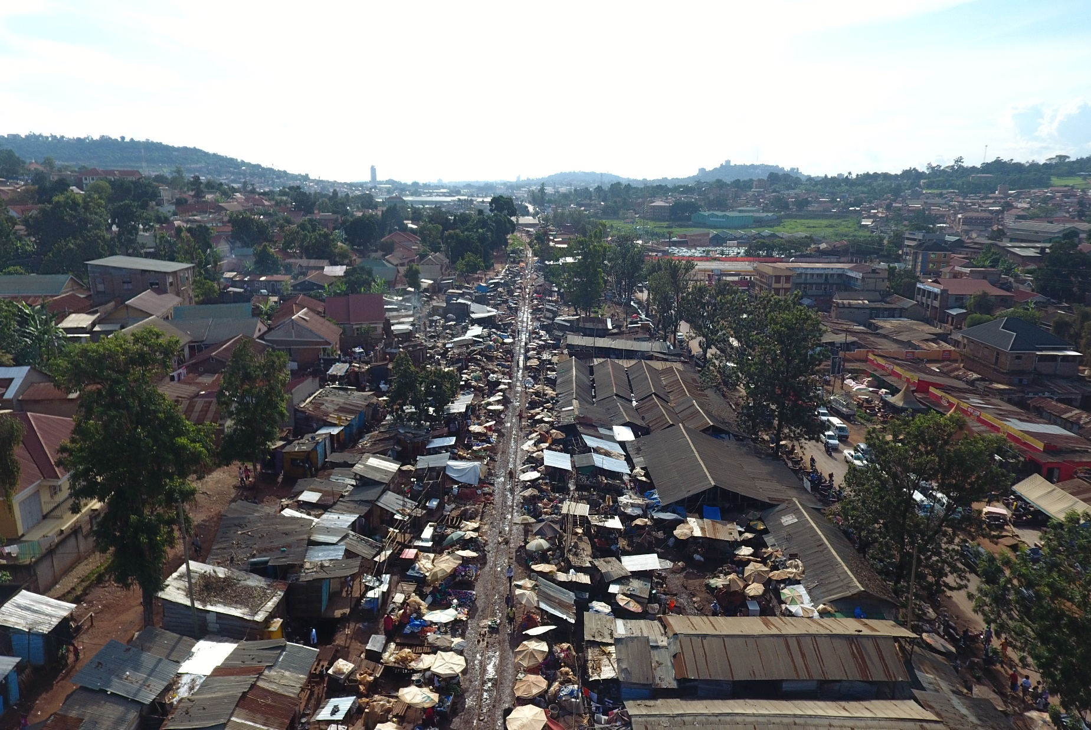
Kireka Farmers Market
▪ Informality has compromised existing infrastructure e.g Railway and roads

Slide 34
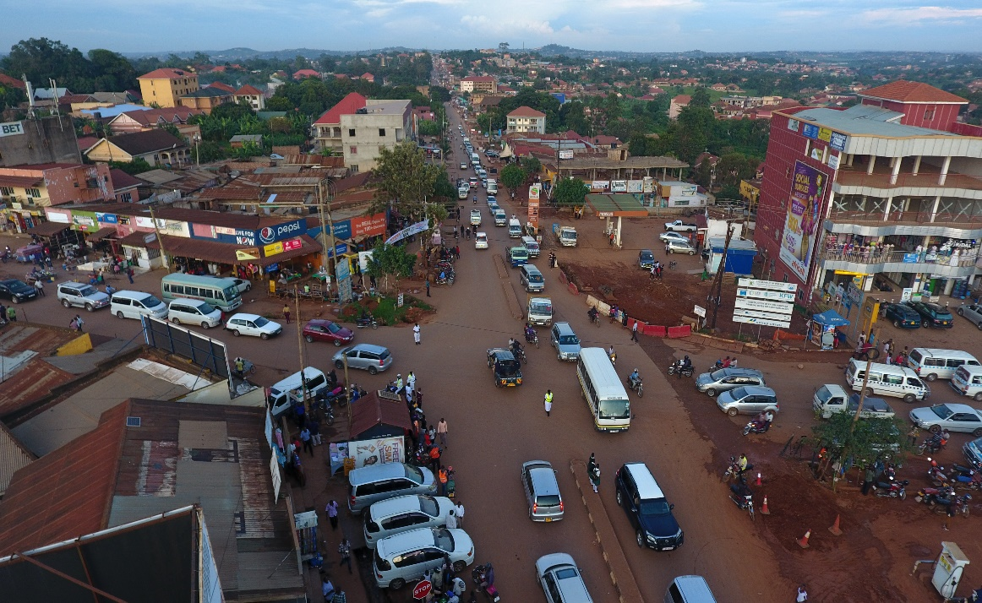
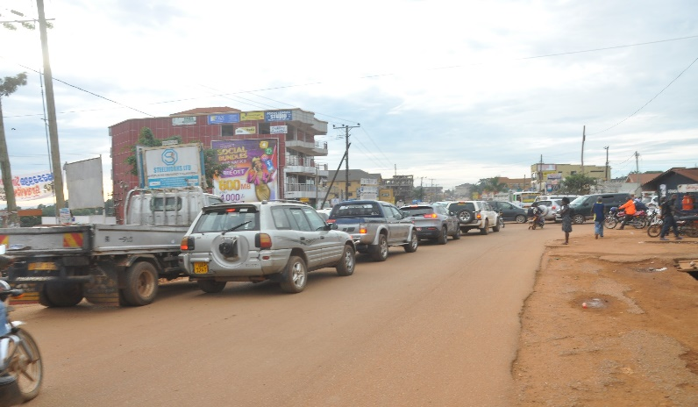
DEVELOPMENT CHALLENGES CONT’D-ROAD SAFETY
Intersections
Traditional 3 or 4 arm intersections that are unsafe due to many conflict zones. Causing traffic jam
Road Sections.
Major Roads have many un-controlled local area access roads causing jams due to frequent traffic flow interruptions .
Roads lack vehicle stop areas to curtail vehicles stoppages within the carriageway, road section narrows reducing clearance for passing vehicles.

Slide 35
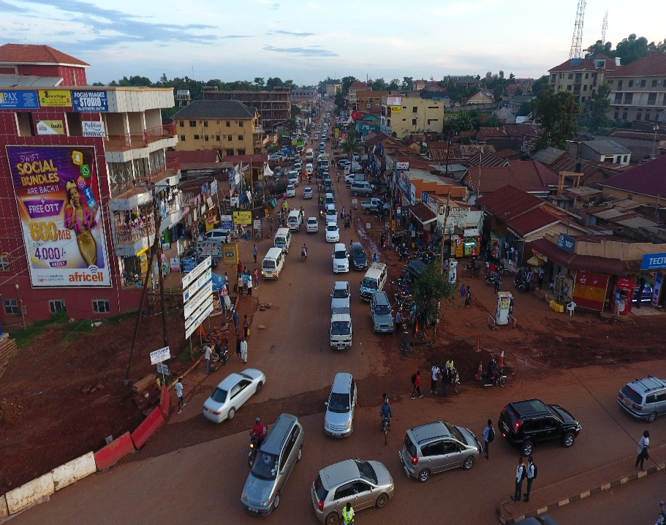
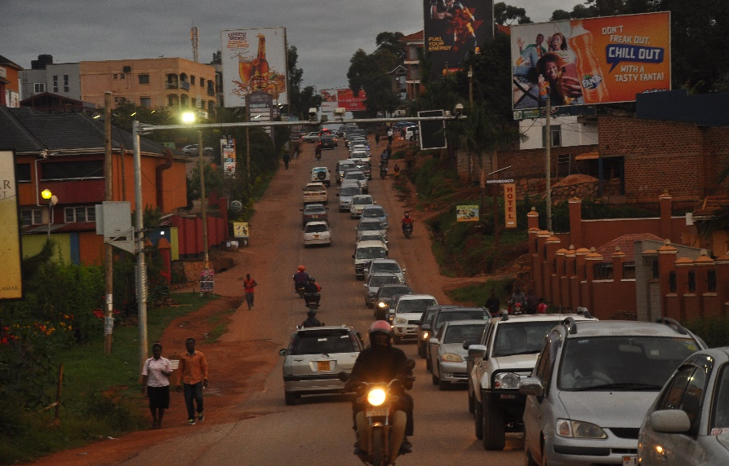
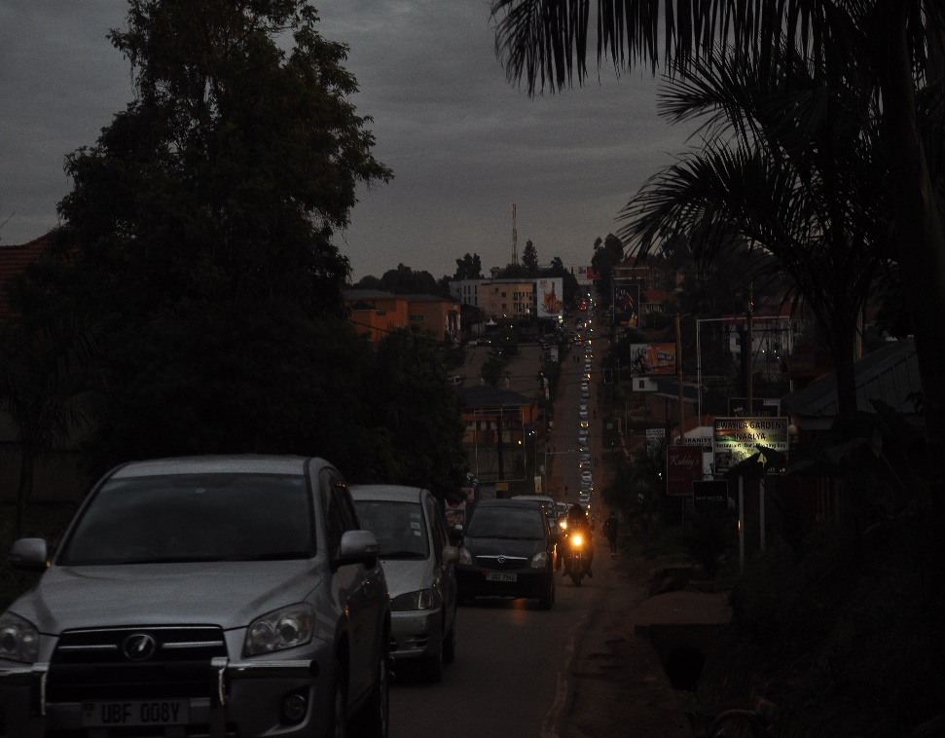
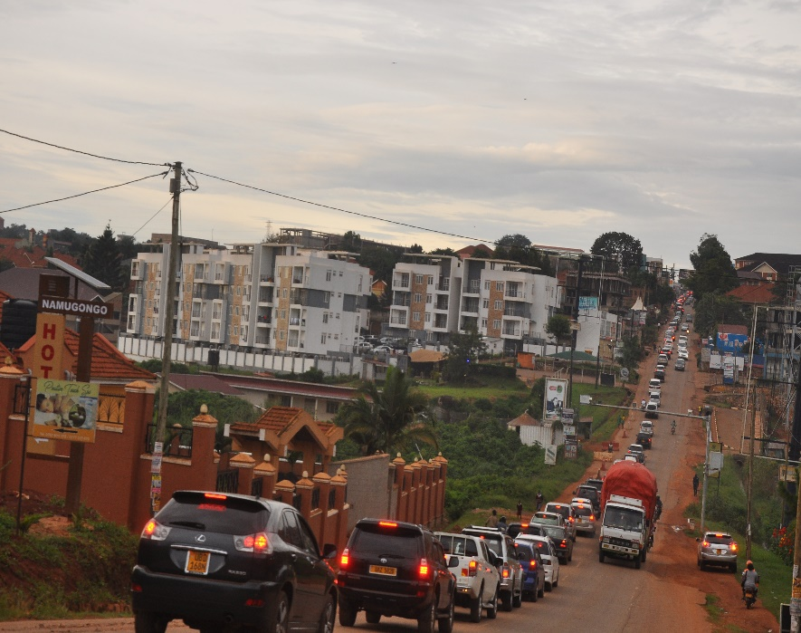
Snapshot of traffic jam(Naalya, Kyaliwajjala, Najjeera, Bweyogerere

Slide 36
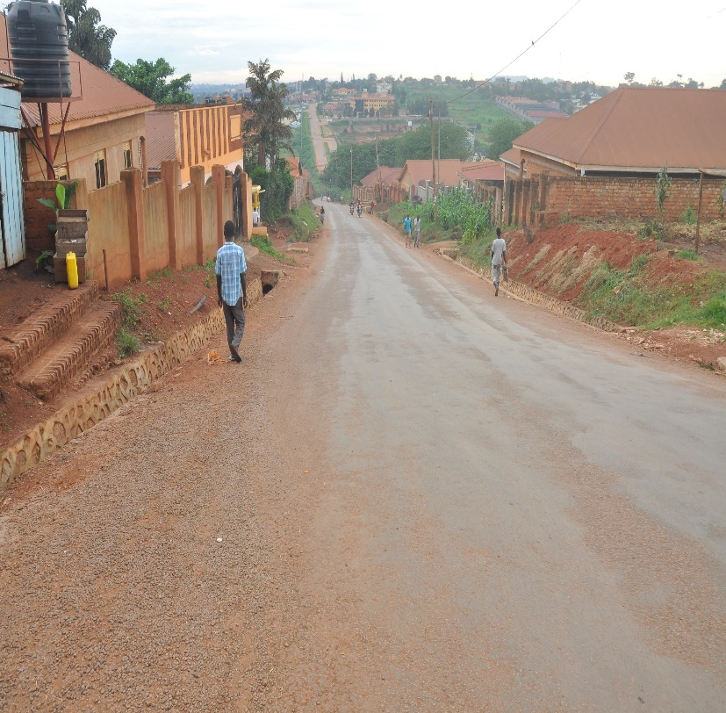
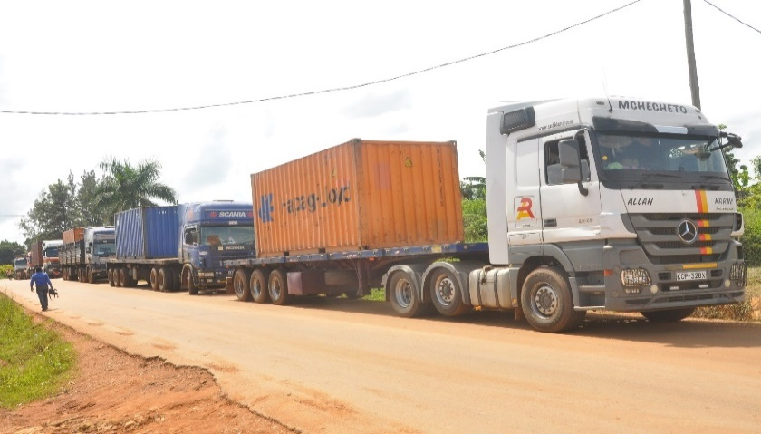
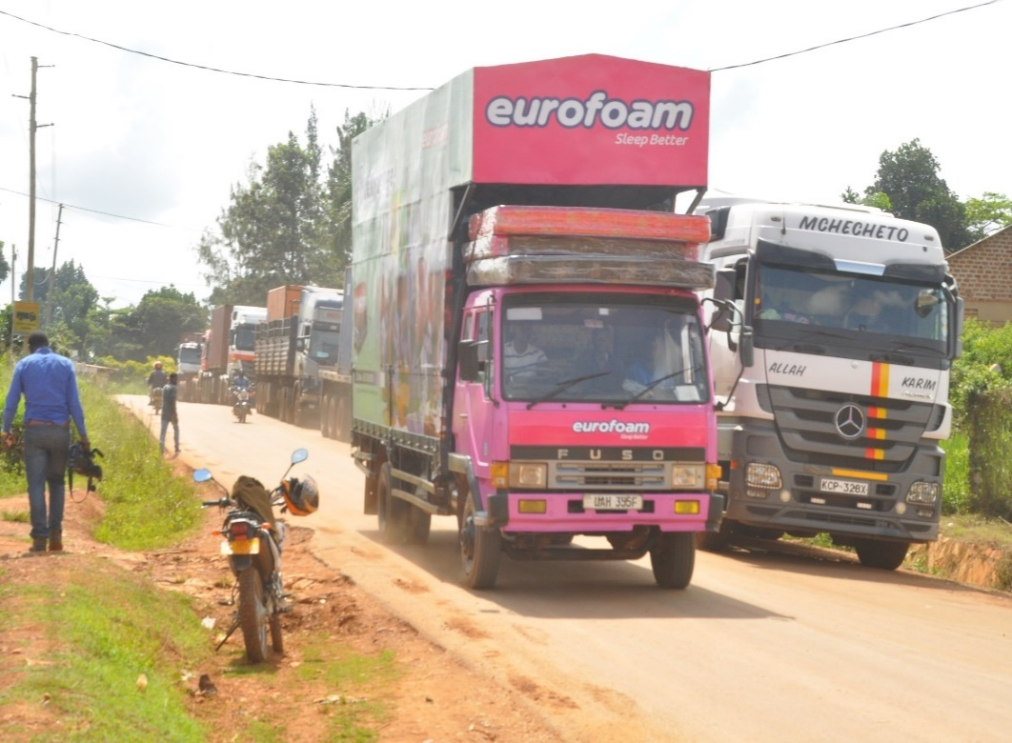
DEVELOPMENT CHALLENGES CONT’D-ROAD SAFETY
Current road network is 292 Kms
50 Km is single sealed: Posing sustainability challenges especially with current traffic and heavy vehicles. Asphalt pavement is preferred(see next slide)
Most roads within the municipality are highly trafficked which cause pressure on existing network. This is because all the central government roads which go through the municipality are highly trafficked.
Periodic maintenance is Ugx1.2m per km

Slide 37
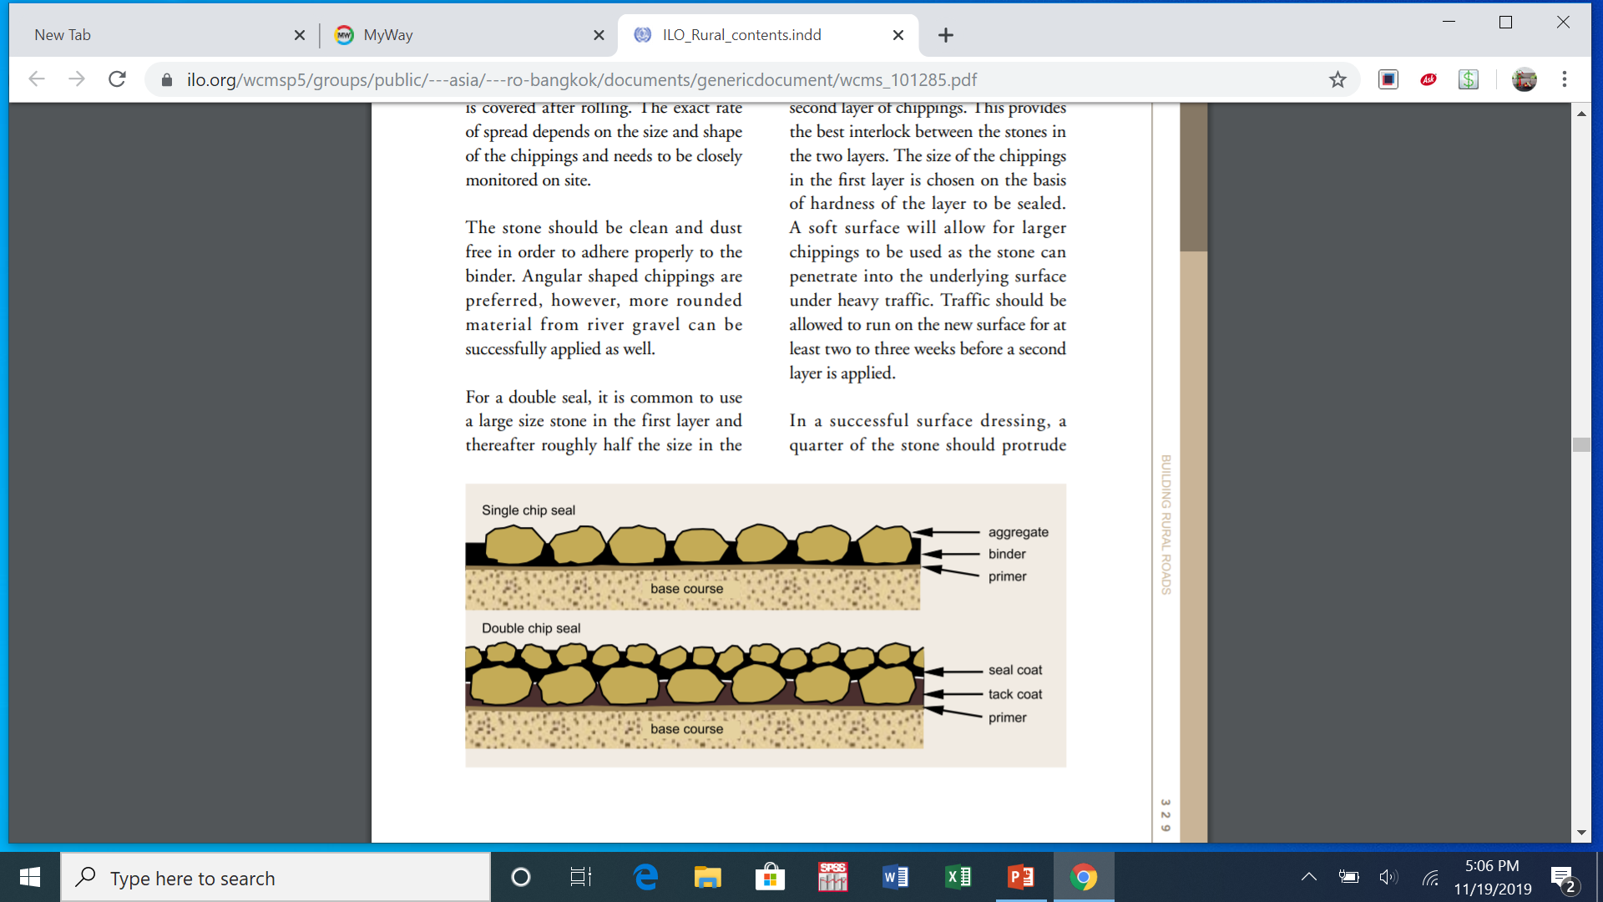
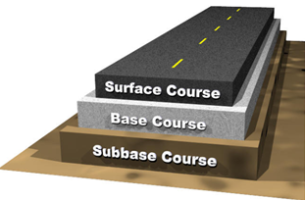
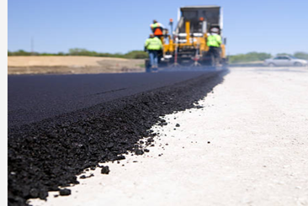
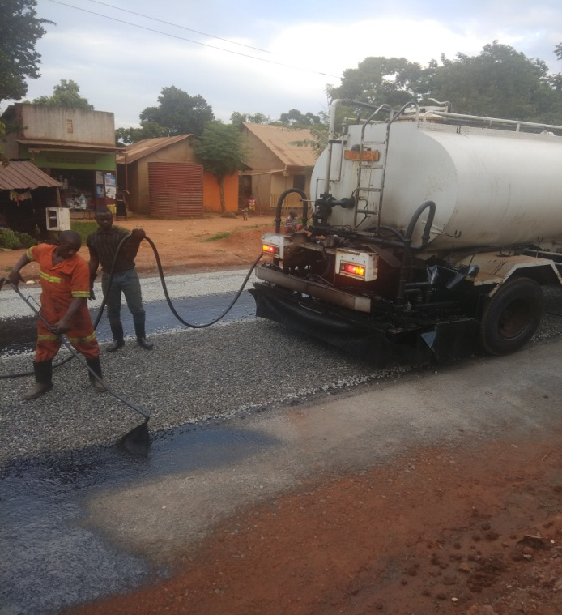
Difference between Surface dressing and Asphalt pavement
Surface Dressing
Asphalt Pavement(preferred)
Cost Per Km Ug. Shs. 650,000,000/=
(currently being used by KIRA)
Cost Per Km Ug. Shs. 1,732,182,909/=
Cost Per Km Ug. Shs. 2,918,728,202/= without drainage, walk ways and street lights

Slide 38
Roads –inadequate road equipment; what kira mc has
No | Description | Qty | Year of acquisition
1 | Motor Grader | 01 2007
2 | Wheel Loader | 01 2009
3 | Ped Roller | 01 2017
4 | Pick-up | 01 2018
Most of the above are old, in poor mechanical state with high maintenance costs

Slide 39
Roads –inadequate road equipment pictures

Slide 40
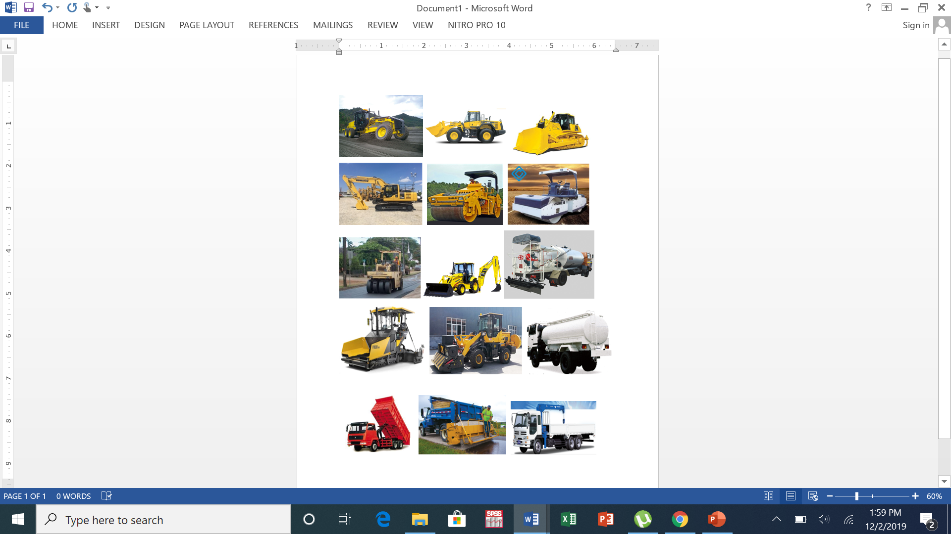
Roads –pictorial of a complete road equipment

Slide 41
Dev’t Challenges: Comparative figures with other MCs

Slide 42
Dev’t Challenges: Solid waste in Kira MC
Currently MOST waste is dumped in non-designated sites.
Inadequate funding to manage current waste
Inadequate garbage trucks
The Municipality acquired land for management of solid waste. There is need to access funding to develop the land into garbage disposal site

Slide 43
Planned Interventions-3 Years
INTERVENTION | QTY | COST PER UNIT(UGX) | TOTAL
ROADS
1. Acquisition of a new caterpillar Grader | 1 | 1,800,000,000 | 1,800,000,000
2. Acquisition of a new 10 Ton Vibro Roller | 1 | 590,000,000 | 590,000,000
3. Acquisition of a water bowser | 1 | 320,000,000 | 320,000,000
4. Acquisition of a Back Hoe | 1 | 620,000,000 | 620,000,000
5. Acquisition of a Bitumen Sprayer | 1 | 1,200,000,000 | 1,200,000,000
6. Upgrade to USMID standard Roads(Kms) | 24 | *4,200,000,000 | 100,800,000,000
7. Stone Pitching(Kms) | 80 | 72,800,000 | 5,824,000,000
8. Periodic Maintenance(Kms)-40 Kms per FY | 120 | 50,000,000 | 6,000,000,000
*cost includes drainage and solar street lights

Slide 44
Planned Interventions-3 Years
INTERVENTION | QTY | COST PER UNIT(UGX) | TOTAL
HEALTH |  |  | -
9. Acquisition of garbage trucks(16 ton each) | 3 | 800,000,000 | 2,400,000,000
10. Development of the recently acquired 12 acres of the proposed waste disposal site at Menvu | 1 | 8,000,000,000 | 8,000,000,000
11. Construction of maternity wings at all the existing health facilities | 5 | 350,000,000 | 1,750,000,000-
12. Construction of Sewer Lagoons | 3 | 5,500,000,000 | 16,500,000,000

Slide 45
Planned Interventions-3 Years
INTERVENTION | QTY | COST PER UNIT(UGX) | TOTAL
EDUCATION
13. Construction of a resource center at Butto | 1 | 500,000,000 | 500,000,000
14. Construction of storeyed classroom blocks | 3 | 2,500,000,000 | 7,500,000,000
15. Development of a recreational center at Bulindo Council Land(5 acres) | 1 | 800,000,000 | 800,000,000
ADMINISTRATION
16. Completion of Municipal Admin Block and Construction of Division Offices | 4 | 2,800,000,000 | 2,800,000,000

Slide 46
Planned Interventions-3 Years
INTERVENTION | QTY | COST PER UNIT(UGX) | TOTAL
PRODUCTION AND MARKETING
17. Construction of modern markets at Kireka, Bweyogerere and Kitukutwe | 3 | 1,000,000,000 | 3,000,000,000
18. Setting up a tourism information centre at Namugongo Division Offices | 1 | 600,000,000 | 600,000,000
19. Establishment of an Income Generating project for the Municipality | 1 | 500,000,000 | 500,000,000
20. Implementation of the Namugongo detailed plan | 1 | 180,000,000 | 180,000,000
NATURAL RESOURCE |  |  | -
21. Establishment of GIS Unit to support turnaround time, attraction of investors, improving revenue collection, movement of people and general security of the environment | 1 | 280,000,000 | 280,000,000
TOTAL BUDGET |  |  | 161,964,000,000

Slide 48
Other Planned Long Term Interventions
Activity | Implementation Period | Indicative Cost(USD)
Capacity building of technical staff | 5 years | 380,000
Develop the Kira Bypass Road | 4 years | 67,000,000
Repair all the drainage and landscape the main streets in the CBD | 15 years | 2,000,000
Develop a light rail from Nakwero to Kireka to Bukasa(20.8 Km) | 15 years | 280,000,000
Develop a modern transportation terminal at Bukasa | 18 years | 5,500,000
Develop a computerized register for local revenue enhancement and E-tax collection | 3 years | 3,700,000
Modern solid waste treatment plant | 5 years | 165,000
Develop all municipal roads(190 Km) with drainage works | 20 years | 153,000,000

Slide 49
Planned Long-term Interventions-cont’d
Activity | Implementation Period | Indicative Cost(USD)
Acquire and develop land to attract investment in low cost housing at Kireka | 10 years | 10,000,000
Plan and develop the artisan industrial park at Kitukutwe in Kira Division | 8 years | 150,000,000
Plan and service the industrial park at Kazinga-Kireku | 15 years | 25,000,000

Slide 50
Concluding remarks
A number of achievements have been highlighted –mainly as a result of using local revenue and central government grants
There are also opportunities and challenges that have been highlighted
The Municipality therefore proposes quick wins to address the identified challenges-see next slide

Slide 51
Concluding remarks….
Quick wins:
Lobbying Ministry of Finance to increase funding allocation for roads
Lobbying Ministry of Finance to give a special grant for road works. i.e USMID
Request to Ministry of Works and UNRA to assign machinery for road construction and repair(grader, roller, wheel loader, dump truck, distributor, chip spreader, pneumatic roller)-any that can be available
Funding for three high volume trafficked roads:
  Najjera-Kira –Bulindo-Kiwologoma to Nakwero stretch(11.1 Km)
  Naalya-Kyaliwajjala stretch (2.5 Km)
  Bweyogerere-Bbuto -Namugongo stretch(5.6 Km)
Increasing on the wage allocation for Kira Municipality(from 57% to 90%)
Continuous sensitization to our people the difference between property rates and rental tax

Slide 52
Concluding remarks….
Quick wins:
Establishment of an Urban Development Forum-We need 7 volunteers from the stakeholders PRESENT to be part of a 21 member Urban Development Forum
Key roles of the forum-next slide

Slide 53
Concluding remarks….
Roles of the forum:
Monitoring and following up the implementation of resolutions from the Municipality;
Undertaking lobbying and advocacy campaigns to facilitate prioritizing of municipality development issues on the regional, national and local development agendas.

Slide 54

THANK YOU VERY MUCH

